Slide 1
Virtual Reality Therapy
By Phil Friedrich
08/13/10

Slide 2
What is your topic (discovery, technology, research)?
Use of virtual reality “worlds” to treat pain and anxiety disorders
“Virtual reality is not just changing the way patients interpret incoming pain signals; the programs actually reduce the amount of pain-related brain activity.”

Slide 3
Background information…
Pain is very much in the brain. Perceptions and thoughts can strongly influence the pain that is “felt”.
Human attention is like a “spotlight”
The mind can be distracted and fooled with music and imagery. This distraction can reduce pain and discomfort.
Mario Kart 64 vs SpiderWorld
Reduced pain with 3-D interactive SpiderWorld
Follow up study: N=12, pain was “twice as severe” using just opioids
Notes:
Pain has a strong psychological component. The same incoming pain signal can be interpreted as more or less painful depending on what the patient is thinking. In addition to influencing the way patients interpret such signals, psychological factors can even influence the amount of pain signals allowed to enter the brain's cortex. Neurophysiologists Ronald Melzack and Patrick D. Wall developed this "gate control" theory of pain in the 1960s [see "The Tragedy of Needless Pain," by Ronald Melzack; Scientific American, February 1990]. Introducing a distraction--for example, by having the patient listen to music--has long been known to help reduce pain for some people. Because To test this notion, we studied two teenage boys who had suffered gasoline burns. The first patient had a severe burn on his leg; the second had deep burns covering one third of his body, including his face, neck, back, arms, hands and legs. Both had received skin-graft surgery and staples to hold the grafts in place.
Pain has a strong psychological component. The same incoming pain signal can be interpreted as more or less painful depending on what the patient is thinking. In addition to influencing the way patients interpret such signals, psychological factors can even influence the amount of pain signals allowed to enter the brain's cortex. Neurophysiologists Ronald Melzack and Patrick D. Wall developed this "gate control" theory of pain in the 1960s [see "The Tragedy of Needless Pain," by Ronald Melzack; Scientific American, February 1990]. Introducing a distraction--for example, by having the patient listen to music--has long been known to help reduce pain for some people. Because virtual reality is a uniquely effective new form of distraction, it makes an ideal candidate for pain control. To test this notion, we studied two teenage boys who had suffered gasoline burns. The first patient had a severe burn on his leg; the second had deep burns covering one third of his body, including his face, neck, back, arms, hands and legs. Both had received skin-graft surgery and staples to hold the grafts in place.
Because patients often report that they are reliving their original burn experience during wound care, we designed a glacial landscape to help put out the fire. As patients glide through the virtual canyon, they can shoot snowballs at snowmen, igloos, robots and penguins standing on narrow ice shelves or floating in the river. When hit by a snowball, the snowmen and igloos disappear in a puff of powder, the penguins flip upside down with a quack, and the robots collapse into a heap of metal.

Slide 4
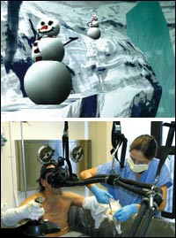

Slide 5
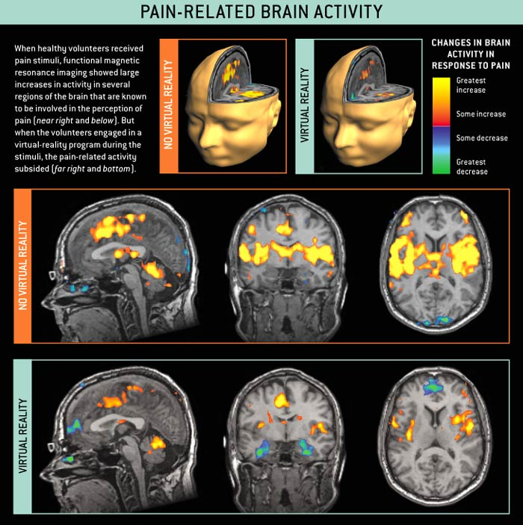
Notes:
What is more, improving the quality of the virtual-reality system increases the amount of pain reduction. In another study, 39 healthy volunteers received a thermal pain stimulus--delivered by an electrically heated element applied to the right foot, at a preapproved temperature individually tailored to each participant--for 30 seconds. During this stimulus, 20 of the subjects experienced the fully interactive version of SnowWorld with a high-quality headset, sound effects and head tracking. The other 19 subjects saw a stripped-down program with a low-quality, see-through helmet, no sound effects, no head tracking and no ability to shoot snowballs. We found a significant positive correlation between the potency of the illusion--how strongly the subjects felt they were immersed in the virtual world--and the alleviation of their pain. Seeing Pain in the Brain Of course, all these studies relied on the subjective evaluation of the pain by the patients. As a stricter test of whether virtual reality reduces pain, I set out with my colleagues at the University of Washington--including Todd L. Richards, Aric R. Bills, Barbara A. Coda and Sam Sharar--to measure pain-related brain activity using functional magnetic resonance imaging (fMRI). Healthy volunteers underwent a brain scan while receiving brief pain stimulation through an electrically heated element applied to the foot. When the volunteers received the thermal stimuli without the distraction of virtual reality, they reported severe pain intensity and unpleasantness and spent most of the time thinking about their pain. And, as expected, their fMRI scans showed a large increase in pain-related activity in five regions of the brain that are known to be involved in the perception of pain: the insula, the thalamus, the primary and secondary somatosensory cortex, and the affective division of the anterior cingulate cortex [see illustration on page 61].

Slide 7
Why did you choose this topic?
Virtual reality is an up and coming form of technology and I was initially doubtful that a “video game-like experience” could inhibit very real pain.
I have suffered from a wide variety of pains, many of which were undertreated. I am curious if this new treatment will be widely used for many patients.
I have recognized that people have different pain tolerances and some can almost ignore pain completely through their will.
Notes:
Virtual Reality is a uniquely effective new form of distraction, it makes an ideal candidate for pain control.

Slide 8
Who is responsible for the reasearch/discovery?
David R. Patterson (University of Washington School of Medicine) and Hunter Hoffman
Harborview Burn Center in Seattle, Patterson and Hoffman set out in 1996 to determine whether immersive virtual-reality techniques could be used to distract patients from their pain.
University of Washington Human Interface Technology Laboratory (HITLab).
Technological progress has allowed for this therapy to become a reality.

Slide 9
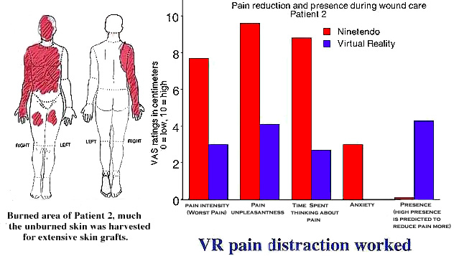

Slide 10
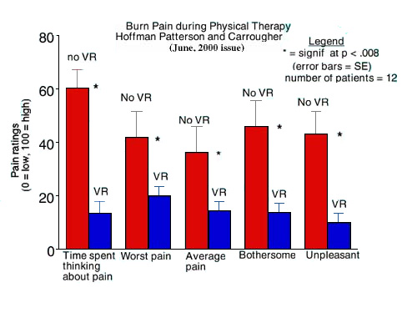

Slide 11
How does this science or technology influence society?
Saves money on expensive pain therapies and treatments (insurance dollars)
SuperSnowWorld will be offered to medical centers free of charge by the Hearst and Harborview burn centers.
Reduces the risk of opioids and allows for more aggressive wound care.
Potential to treat other ailments by “distraction” seems promising. (phobias, PTSD)
http://seattletimes.nwsource.com/ABPub/collections/video/2003995704_virtualreality/2003995717_snowworldvideo.html

Slide 12
What do you think?
Great Idea-worth the money and time spent on development.
Cuts health care costs will be offered free of charge to hospitals
Improves quality of life for suffering people
May reduce drug-dependency
Appears harmless
Large variety of uses: surgery, physical therapy, psychological disorders, going to the dentist, burn treatment, fear of public speaking, etc.
Water-friendly VR helmet – only photons not electrons go to the patient’s head

Slide 13
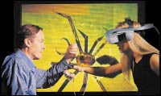
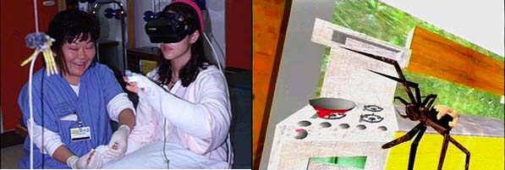

Slide 14
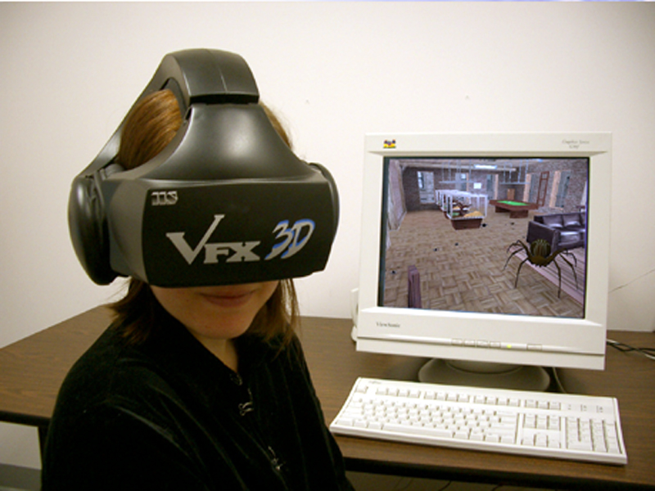
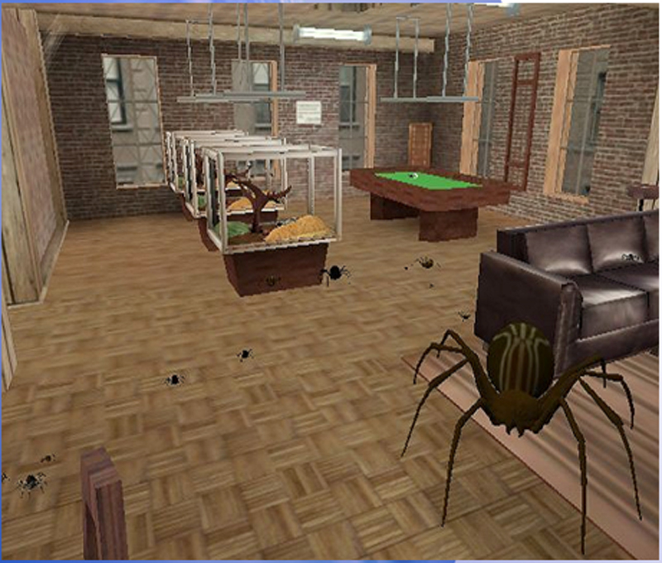

Slide 16
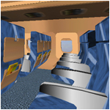

Slide 17
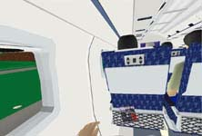
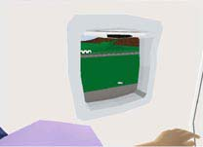
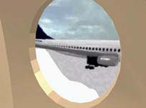

Slide 18
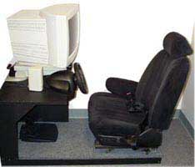

Slide 19
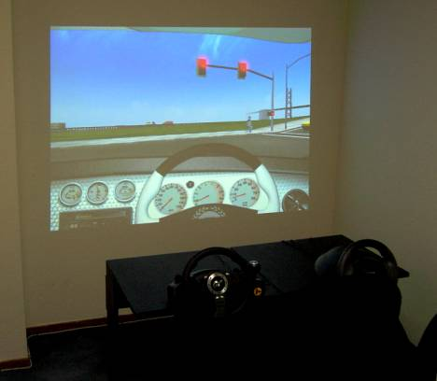

Slide 21
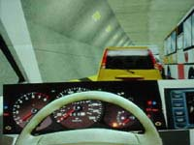

Slide 22
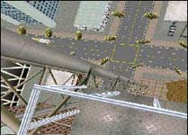

Slide 25
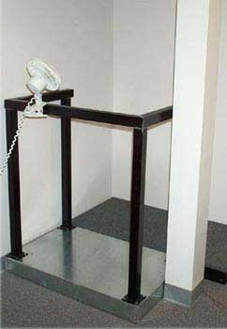

Slide 29
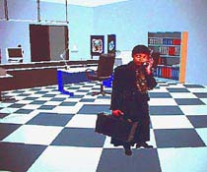
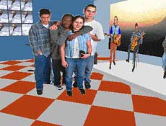

Slide 30
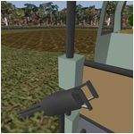
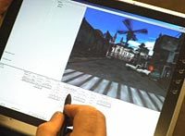
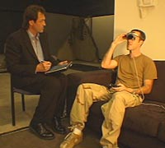

Slide 31
Two questions you would want to ask the scientist(s)
What might be the differences for patients who have extended time in front of the television and or with video games? Would they be more/less responsive?
How much money will actually be saved by moving towards virtual therapy?

Slide 32
Where did you find information on your topic?
Hoffman, Hunter (2004) Virtual Reality Therapy, Scientific American
http://www.hitl.washington.edu/people/hunter/ wtc.pdf
Virtual Reality Medical Center http://www.vrphobia.com/
Virtual Reality Exposure Therapy for World Trade Center Post-Traumatic Stress Disorder: A Case Report. JoAnn Difede and Hunter G. Hoffman in CyberPsychology & Behavior, Vol. 5, No. 6, pages 529-35; 2002.

Slide 33
I am cooler than you!
I

